Slide 1
Simulated
Simulated
Simulated
annealing
annealing
annealing
By Stas Polianychko, Volodymyr Mishchuk, oleksiy orlyk

Slide 2

WHat is it?
Simulated Annealing (SA) is inspired by the process of heating and cooling metals. When metal is very hot, its atoms move around a lot, which helps it take different shapes. As it cools down slowly, the atoms settle into a more stable, strong structure.
SA copies this idea by starting with a lot of "freedom" to make big moves and gradually "settling" as it narrows down to the best solution.

Slide 3
why is it useful?
Simulated Annealing (SA) is an optimization method that starts with a random solution and a high "temperature", which allows it to test different options. As the temperature slowly decreases, SA becomes more selective, sticking to better solutions as it "cools" down.

Slide 4
Initialize solution and temperature
While temperature is high: Generate new solution by slightly changing current one
If new solution is better, accept it
If worse, accept it with a probability based on temperature
Decrease temperature
Return best solution found
Temperature: A control value that starts high and gradually lowers, influencing the algorithm’s willingness to explore worse solutions early on.
Cools/Heats: Cooling means gradually reducing the temperature, which makes the algorithm more selective over time.

Slide 5
Properties
Randomness: They use randomness to explore different solutions, helping avoid getting stuck in local optima.
Objective Function: This function measures the "cost" or "fitness" of a solution, guiding the algorithm toward optimal solutions.
Acceptance Probability: Allows worse solutions to be accepted based on probability (controlled by a parameter like "temperature"), enabling broader exploration.
Cooling Schedule: Defines how a parameter like "temperature" gradually decreases, shifting the algorithm from exploration to fine-tuning.
Termination Condition: A stopping point, often set by a low temperature, a maximum number of iterations, or a minimal improvement threshold.

Slide 6
SA algorithms and problems that can be solved by them
Traveling Salesman Problem (TSP)
Job Scheduling
Resource Allocation
Machine Learning Model Tuning
Circuit Design and Layout

Slide 7
Real World Problems Solved with SA
Airline Crew Scheduling
Data Center Optimization
Telecommunications Network Design
Circuit Design in Electronics
Delivery Route Optimization
Portfolio Optimization in Finance
Scheduling in Manufacturing
Air Traffic Management
Protein Folding in Biotechnology
Urban Planning and Land Use

Slide 8
Example Research Problem and Model
Traveling Salesman Problem (TSP)
Problem: Salesperson who needs to visit several cities and return to the starting point. The goal is to find the shortest route that visits each city exactly once.
Model: We model the problem as a graph, where cities are nodes and the roads between them are edges with distances (travel costs).
Steps for problem solving:
Start with a random route that includes all cities.
The algorithm gradually changes the route with small adjustments, such as swapping two cities, and calculates the new route’s length.
If the new route is shorter, it accepts it. If it's longer, it may still accept it with a certain probability to avoid getting stuck in local minimum.
By slowly cooling the temperature, the algorithm focuses on increasingly better solutions until it finds an optimal route.

Slide 9
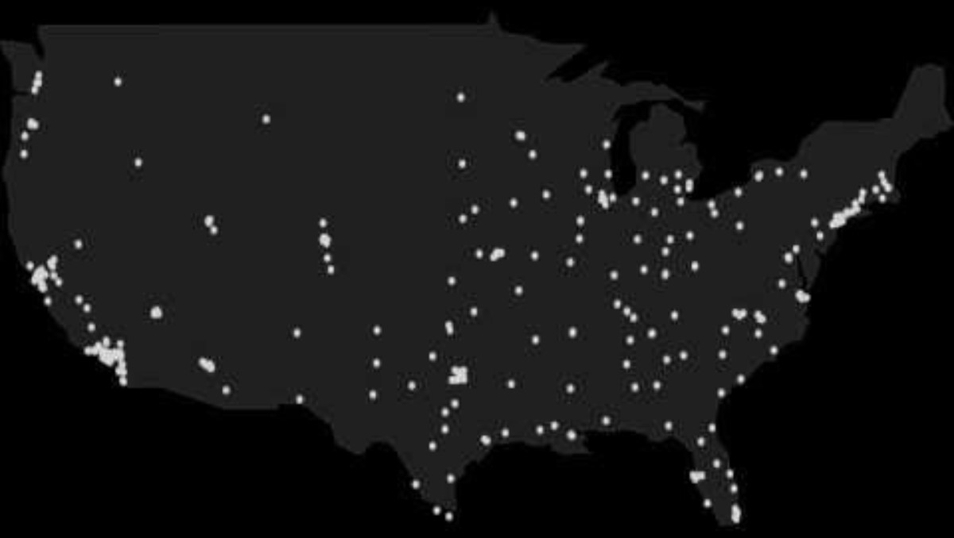

Slide 10
Experiments Results
Testing Case 1: Baseline Setup
Provided Configurations: 10 cities, 10000 initial temperature, 0.99 cooling rate
Results:
Best Route Found: [(34, 46), (25, 3), (33, 12), (38, 55), (56, 69), (70, 76), (77, 75), (93, 98), (56, 87), (37, 57)]
Total Distance of Best Route: 258.32
Iterations: 917
Execution Time: 0.0126 seconds

Slide 11
Testing Case 2: Faster Cooling Rate
Provided Configurations: 10 cities, 10000 initial temperature, 0.95 cooling rate
Results:
Best Route Found: [(84, 88), (92, 81), (100, 78), (86, 37), (63, 8), (58, 45), (38, 12), (31, 29), (11, 91), (55, 74)]
Total Distance of Best Route: 338.34
Iterations: 180
Execution Time: 0.0024 seconds

Slide 12
Testing Case 3: Higher Initial Temperature and Slower Cooling
Provided Configurations: 10 cities, 20000 initial temperature, 0.995 cooling rate
Results:
Best Route Found: [(100, 15), (94, 36), (78, 35), (70, 82), (42, 94), (27, 58), (17, 49), (20, 5), (57, 38), (75, 25)]
Total Distance of Best Route: 311.27
Iterations: 1976
Execution Time: 0.0259 seconds

Slide 13
Summary
Quality vs. Speed Trade-off
Balanced Configuration
Temperature and Cooling Rate Impact

Slide 14
Thank you for attention

